Slide 1
Cars 365
Team members : Indra Shekar G (19z219)
Manoj S (19z263)
Sanjai M (19z241)
Soumen Saha (19z245)
Mathana Sekaran T (19z264)
Gowtham T (19z214)

Slide 2
Contents
01
02
03
04
Introduction
Overall Description
Features
Quality Attributes

Slide 3
Introduction
The purpose of the cars365 online platform is to ease car trading and to create a convenient and easy-to-use application for car buyers and sellers. The system is based on a database with its buy, sell, rental and price prediction functions. We will have a database server supporting hundreds of major cities around India as well as hundreds of cars by various automobile manufacturers. Above all, we hope to provide a comfortable user experience along with convincing price predictions available.

Slide 4
Quick Facts
75%
38 H
of cars that Rolls Royce has produced are still on the road today.
The average American spends about 38 hours a year stuck in traffic.

Slide 5

Overall Description
Though modern evolution in technology is said to be something comparatively new, the process of evolution has been on a constant change, with advancements of all sorts, making us think how technology has changed our lives, pretty much overnight! Nowadays everything has become online, from ordering food to booking a ticket for darshan in a temple. So we thought of developing a software called cars365 by which customers can easily fulfil there dreams.

Slide 6
3 Main portals
Renting portal
Buying portal
Auctioning portal
This page is for the users who wish to rent cars for a certain period of time.
This portal provides an interface for buyers who are searching used cars to buy and through this, they can connect to the sellers using the provided contact information.
Auctioning portal is for the vintage car sellers who can post their cars and conduct real time auctions.

Slide 7
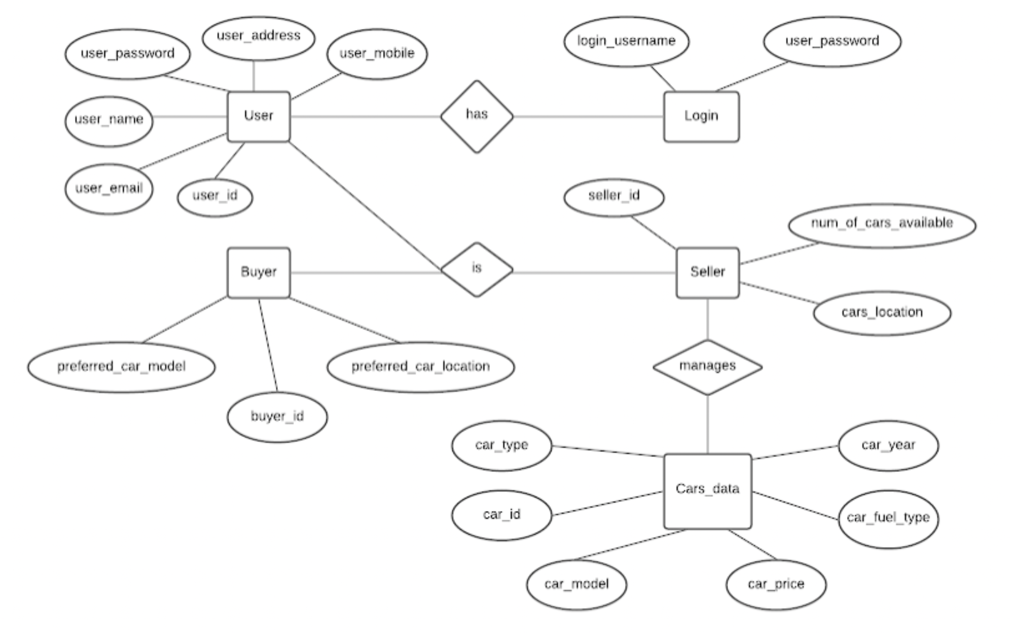
ER model

Slide 8
Operating system: Any operating system which supports web browsers.
Database: Google Firebase
Front End Software: Html, CSS, JavaScript
Back End Software: JavaScript, Google Firebase, Python

Slide 9



Features
Price Prediction
Cars Dashboard
Comparision between cars
The car price predictor is a ML model which predicts the prices of the used cars based on the data provided by sellers.
This dashboard provides useful charts and tables of car sales and trends of buyers and sellers.
This page is handy for buyers who tend to compare multiple cars for selecting the best one out.

Slide 10
Quality Attributes
Correctness : The seller and car details should be legit since many buyers would be making contacts and enquiries.
Availability: This car should be available in the listed location with the recorded attributes.
Maintainability : The owners and sellers should maintain a correct availability list of cars with accurate attributes and locations.
Usability : The car information should suffice the preferences and requirements of the buyers.

Slide 11

Thank you
For your attention
Team members : Indra Shekar G (19z219)
Manoj S (19z263)
Sanjai M (19z241)
Soumen Saha (19z245)
Mathana Sekaran T (19z264)
Gowtham T (19z214)

